Slide 1
Sport for Development Research Mapping 7th June 2011
Tel. +44 151 6250305
email: orla@orlacronin.com
Web: www.orlacronin.com

Slide 2
Outline
Background to the research
Methods, sample and caveats
Descriptive results
Issues identified
Questions?
Full report available at http://www.orlacronin.com/home-2/civil-society/research-design-and-method-development/ or at http://tinyurl.com/62p9nhs

Slide 3
Background
Perception that the sector had grown exponentially since CR’s last report in 2007
CR updating strategy and priorities for its Sport for Change programme
At Myles Wickstead/UK Sport meeting in July 2010, the themes of “understanding the nature of our evidence base”, and “reducing fragmentation” emerged
CR undertook to conduct the research and report back
Notes:
As part of its 2010/2011 Sport for Change programme, Comic Relief undertook to commission a mapping exercise of research in the area of Sport for Development (SfD). At a meeting initiated by Myles Wickstead and convened by UK Sport in July 2010, the theme of understanding the nature of our evidence base, and reducing fragmentation/duplication of research effort emerged.

Slide 4
Methodology and caveats
‘Mapping research’ => “what is research?”
Data collection – reasonable ‘saturation’
Interviews (12 informants, from a contact list provided by CR)
Emails from 60 academic/independent researchers, including samples of research completed/in progress
Academic and grey literature (proactive searches and material received)
This was a SAMPLE, not a comprehensive and exhaustive cataloguing - coarse rather than fine grained.
Notes:
Mapping the sector required us to consider what we meant by research. The distinction between evaluation and research can be extremely blurred within the sector, but itis important, as different quality standards apply, and they have different functions. I could expound on this at length, but I won’t: suffice it to say that when we talk about ‘research’ we’re talking about learning which has relevance above and beyond the particular project we’re considering.
The report does not purport to be comprehensive. We didn’t speak to everyone; we haven’t captured every single piece of research completed since 2007. Many reasons for this – time (especially given the handover of the project midway), resources, constantly evolving, any cut off would be arbitrary. Please treat it as a sample, no more. I’m happy to discuss offline how we could improve the methodology and coverage, but I’m satisfied that we reached reasonable saturation in that addition of more data or informants would not necesarily have raised additional issues or changed the conclusions substantially

Slide 5
Results: Definitions of research quality
Collection of baseline data
Use of thematic experts as well as SfD experts
Use of behavioural as well as self-report indicators (rare)
Data management (for reanalysis/comparison/longitudinal work)
Research should be done ‘with’ rather than done ‘to’
Clarity regarding end use of research
Aiming to publish in peer reviewed journals
Good review, and understanding, of previous research
Carefully validated research tools

Slide 6
Challenges: 1. Strategic
Difficulty in accessing national level statistics
Organisations lacking a theory of change – so ‘no effect’ may be due to design of intervention
Concentrating on what can be measured easily (e.g. self-esteem) to the exclusion of more difficult/resource intensive areas e.g. community cohesion, peacebuilding
Quality of research being conducted (e.g. How to improve the quality of analysis and reporting of qualitative data)
Fragmentation/duplication of research initiatives
Poor dissemination/learning from research
Little methodological innovation
Overdependence on ‘Northern’ researchers

Slide 7
Challenges 2: Practical
Time & expense of translating and validating research instruments & data
Limited local capacity e.g. Research design, data collection, analysis and report writing skills
Resistance to research – onerous, wasteful, irrelevant
Cost of research, in particular when using Northern researchers (why aren’t we using Northern researchers to build capacity?)

Slide 8
Current research emphasis (ISDP)

Slide 9
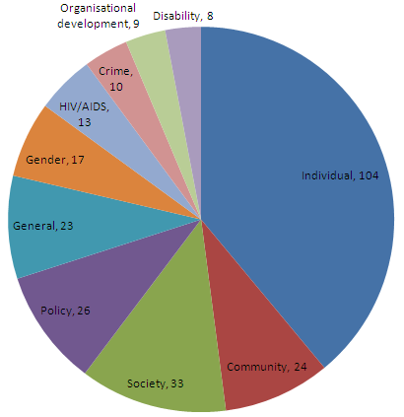
Current research emphasis
Academic articles’
103 ‘Grey’ literature
267 Total

Slide 10
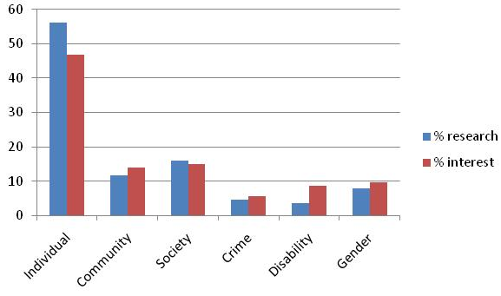
Research vs. ‘interest’ ( N=246 subscribers to www.sportanddev.org

Slide 11
Research gaps
Childhood obesity
Components of a good intervention
Meta-analyses and systematic reviews
Cost-benefit/value for money/social ROI vs. other interventions
Few examples beyond individual level of analysis (family/group/community/society)
Action research and innovative methodologies
General overlap/duplication/fragmentation
Lack of evidence-based argumentation

Slide 12
Research gaps
Thematic areas:
Gender & sport
Gender based violence and sexual harassment
Sport and reproductive health
Economic empowerment and livelihoods

Slide 13
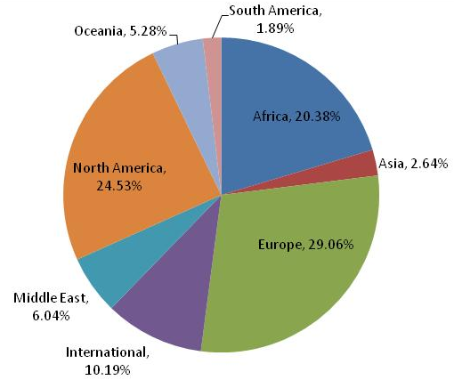
Geographical focus

Slide 14
Location of researchers

Slide 15
Toolkits
15 SfD specific toolkits identified
Wide variety:
What is a ‘toolkit’? (Manual/handbook, IT system, set of questionnaires, framework?)
Expert administered vs. stand alone
Internet enabled vs. manual
Covering the entire project cycle (aims, outcomes, M, E, reporting) or just elements
Primarily knowledge management, or containing embedded tools e.g. Specific questionnaires
Open source vs. licensed vs. fee based
Centralised data management
Qualitative vs. quantitative
Theme specific or generic

Slide 16
Toolkits
Issues emerging:
Retention of copyright vs. open source
Developed collaboratively vs. imposed by funders
Need for investment in training and support
Challenge of internet/IT based materials for low income countries
Evolution – need for mechanisms to incorporate feedback, translations, etc
Concerns about proliferation of requirements
More systematic & detailed comparison and decision tree desirable for users?

Slide 17
Issues identified
From a ‘knowledge brokering’ perspective, the issues can be grouped into:
Problem definition
Knowledge generation
Knowledge use

Slide 18
a) Problem definition
What is the (research) question, and at what level of analysis does it need to be addressed? For whom is it a question? Are there any plans in place to address it? Is there an intention to act on the results?
Reduce the number of broad brush ‘does sport work’ literature reviews and focus on specific claims
Be clear what we mean by ‘monitoring’, ‘evaluation’ and ‘research’. Different quality standards apply to each of these, and they have different audiences and functions.
Reduce duplication by having a research ‘wish lists’, ‘plans’ and ‘in progress’ forum
Involve end users in research design and problem definition

Slide 19
b) Knowledge generation
Does capacity to create this knowledge need to be increased?
What are the most appropriate ways to generate this knowledge? Are we updating and innovating in terms of methodology?
What constitutes ‘knowledge’, and how can the quality of it be evaluated?
How can we improve research quality?
How can we leverage the expertise of thematic experts outside SfD?
How to make more cost-effective use of researchers from HICS, e.g. Using them to build capacity – research skills & collaborations with LICS

Slide 20
c) Knowledge use
Does capacity to access and use this knowledge need to be increased?
What specific activities are needed to translate this knowledge into action?
Does this knowledge need to be managed in a particular way?
How will it be shared?
E.g. Systematic abstracting of research planned, in progress and completed in a centralised repository
Build capacity to understand and use research findings: consider more engaging methods of communicating research, including action planning around the findings.
Budget time and cash for dissemination of research

